Slide 1








Welcome Everyone
prepared by:
Nirmal Khadka
Abishek Pokhrel
Bibek shahi

Slide 2


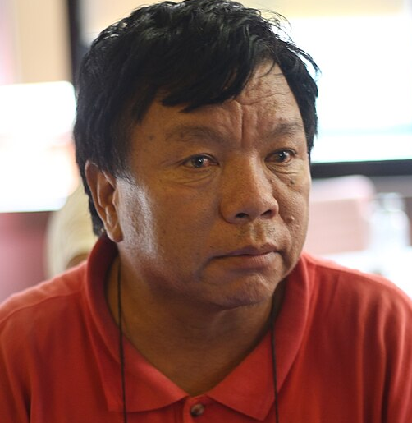



𝐵𝒾𝑜𝑔𝓇𝒶𝓅𝒽𝓎 𝑜𝒻:
𝕸𝖆𝖍𝖆𝖇𝖎𝖗 𝖕𝖚𝖓

Slide 3
Presentation Main Points
Introduction
Achievements
Contributions
Awards
Legacy and Impact
Lessons from His Life
Conclusion

Slide 4



INTRODUCTION
Birth and Childhood:-
-Mahabir Pun was born in Nangi Village, Myagdi District, Nepal in 1955.
-His family belonged to a poor rural community with limited access to education and resources.
Family Background:-
- His father was a soldier in the British Gurkha Army.
- After retiring, his father moved the family to Chitwan for better education opportunities.

Slide 5
INTRODUCTION
Schooling and Higher Education:-
- Due to a lack of schools in his village, he completed his early education in Chitwan.
- After high school, he worked as a teacher for several years because his family could not afford college
Further Studies and Challenges:-
- After years of struggle, he got an opportunity to study in the University of Nebraska, USA.
- He completed a Bachelor's and Master's degree in Science and Education

Slide 6
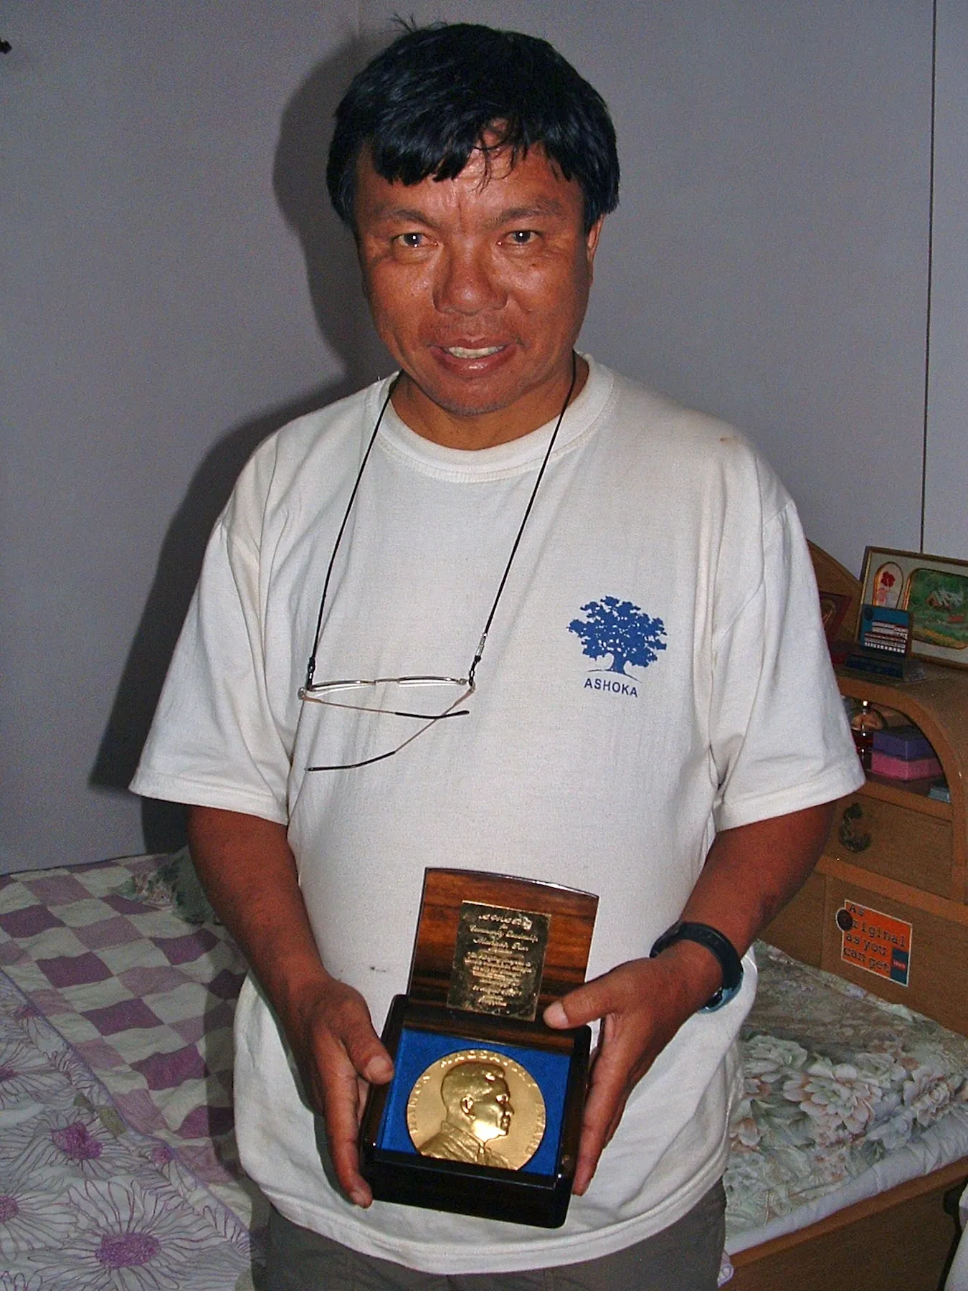

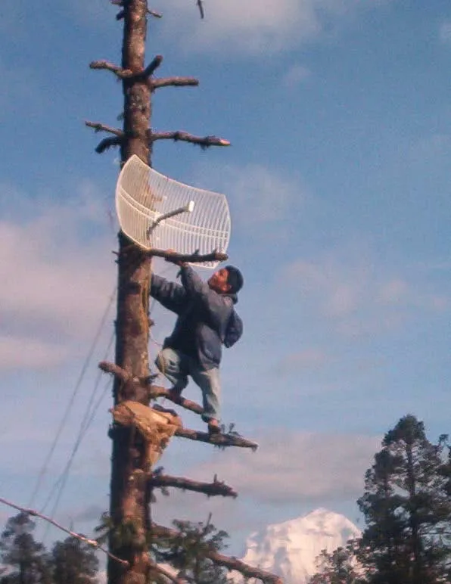
Achievements and Contributions

Slide 7
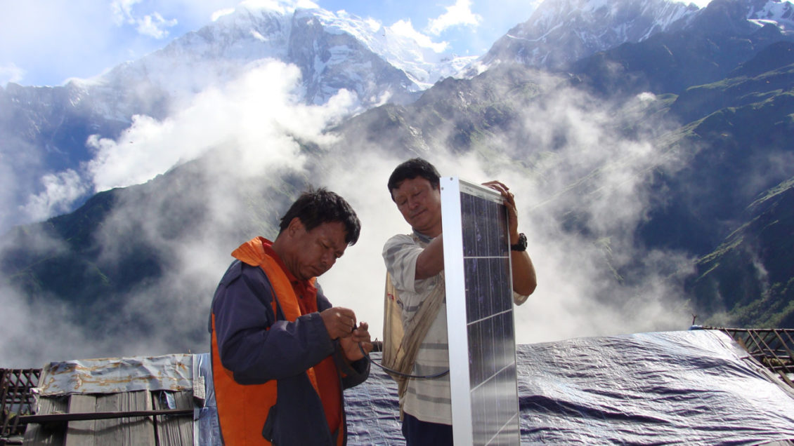
Achievements and Contributions
Nepal Wireless Networking Project:
- After returning to Nepal, he noticed the lack of technology in rural areas.
- He started the Nepal Wireless Networking Project in 2002.
- He connected remote villages to the internet using wireless technology.
Development in Education and Healthcare:
-He introduced e-learning and telemedicine in rural schools and hospitals.
- His efforts helped students and doctors in remote areas access digital learning and medical consultations.

Slide 8
Achievements and Contributions
Promotion of Innovation and Technology:
- He established the National Innovation Center (NIC) in 2012 to support young innovators in Nepal.
- His goal was to develop practical solutions for Nepal's problems through research and technology.
Awards and Recognition:
- Ashoka Fellow for social entrepreneurship.
- The Ramon Magsaysay Award (2007)
- known as the "Asian Nobel Prize."
- Honored by Nepal's government for his contributions to rural develop

Slide 9
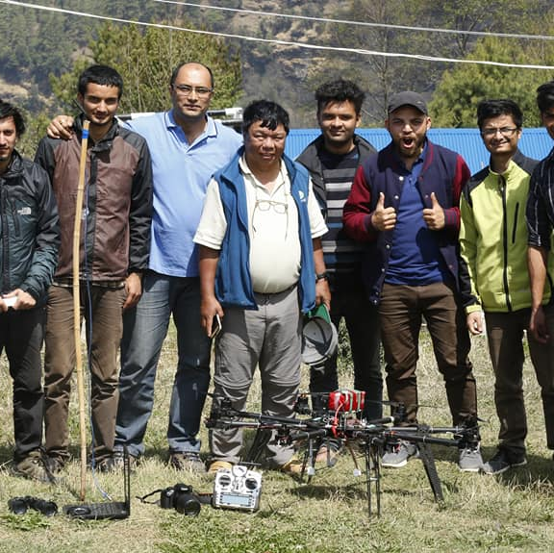
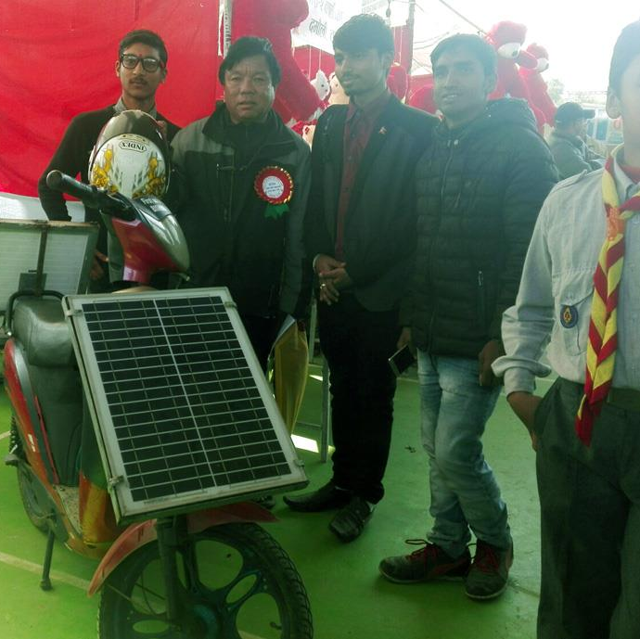
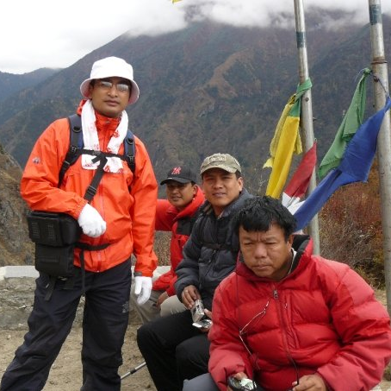
Legacy and Impact

Slide 10
Legacy and Impact
Inspiration for Young Entrepreneurs and Students:
- His work has motivated many young people to focus on technology and innovation.
- He has shown that one person can make a big difference with dedication and hard work.
Role in Nepal's Technological Development:
- His wireless networking model has inspired similar projects in other remote regions of Nepal.
- The National Innovation Center is actively working on solutions for Nepal's problems.
Current Projects and Future Vision:-
-He is working on renewable energy projects and new research centers.
- His goal is to make Nepal self-sufficient in technology and innovation.

Slide 11
Lessons from His Life:
- Never give up, even when facing challenges.
- Education and technology can change lives.
- Innovation can come from anywhere, even from rural villages

Slide 12
Conclusion
This biography highlights
Mahabir Pun's inspiring journey
and contributions to Nepal. His
dedication to innovation and development continues to
impact the country positively

Slide 13


